Slide 1




Mini
Project
Mini
Project

Slide 2



Applying APACHE DORIS in real-time analysis
Applying APACHE DORIS in real-time analysis
Student: Dinh Viet Thanh
Mentor : Pham Cong Minh

Slide 3
Contents
Appendix
Architecture
Features
Core capability
Comparison
A typical use case
Demonstration

Slide 4
Apache Doris Architecture
01
Apache Doris Architecture
01
Notes:
Note: Please after inserting your picture, “Right Click” on the picture and “Send it to Back” to get the “Gradient” effect.

Slide 5

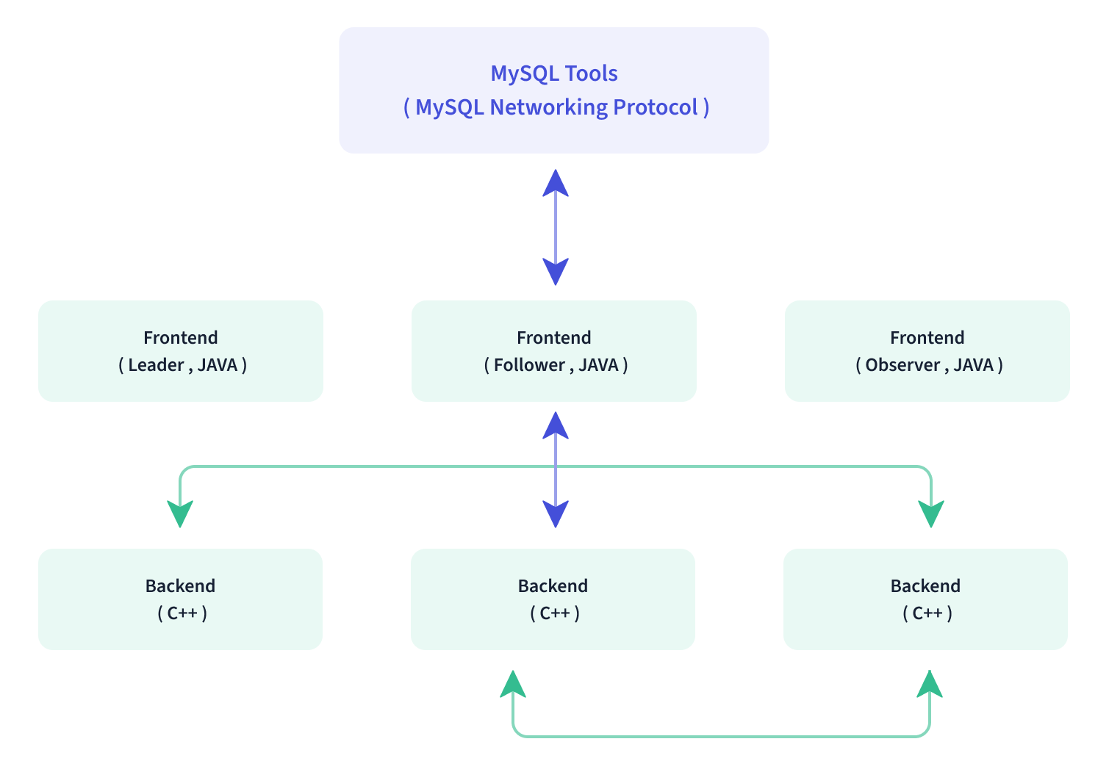
Apache Doris architecture

Slide 6
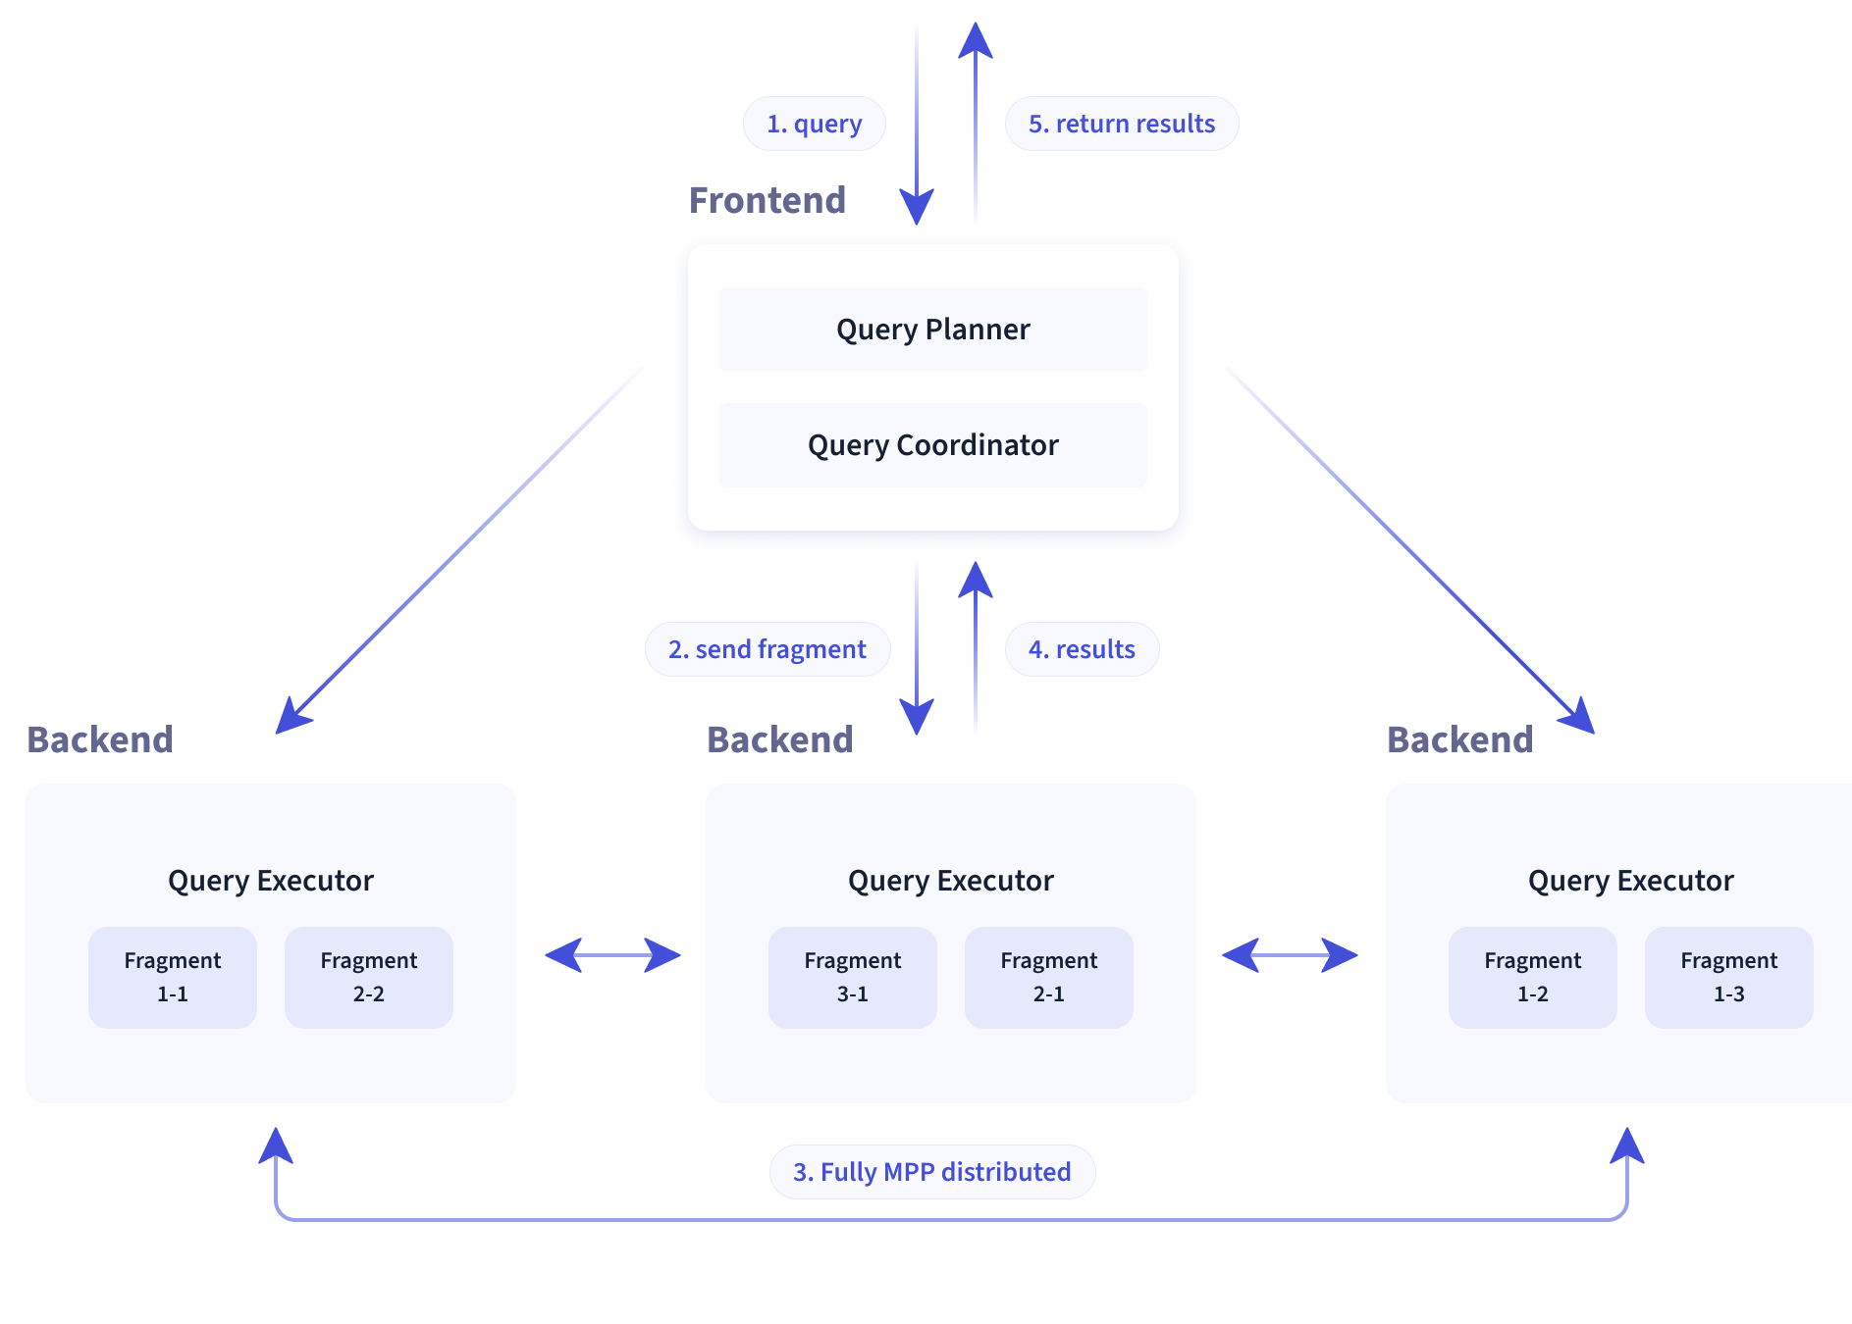
Apache Doris architecture – query engine

Slide 7
Apache Doris
Features
02
Apache Doris
Features
02
Notes:
Note: Please after inserting your picture, “Right Click” on the picture and “Send it to Back” to get the “Gradient” effect.

Slide 8

Cost-based Optimizer - Nereids
Rule-based optimizer
RPO applies a predefined set of rules to transform and optimize queries. These rules are based on heuristics and do not consider the data distribution or query cost.
Cost-based optimizer
CBO use statistical information about the data (table sizes, data distribution, etc) to estimate the cost of different query execution plans. Then, select the plan with the lowest estimated cost.
How can we combine these 2 optimizer?
For each rule, Nereids provides a set of patterns describing query plan, which can exactly match the query plan that can be optimized.
At the same time, the CBO of the Nereids is based on the advanced cascades framework, uses richer data statistics, and applies a cost model with more scientific dimensions.

Slide 9
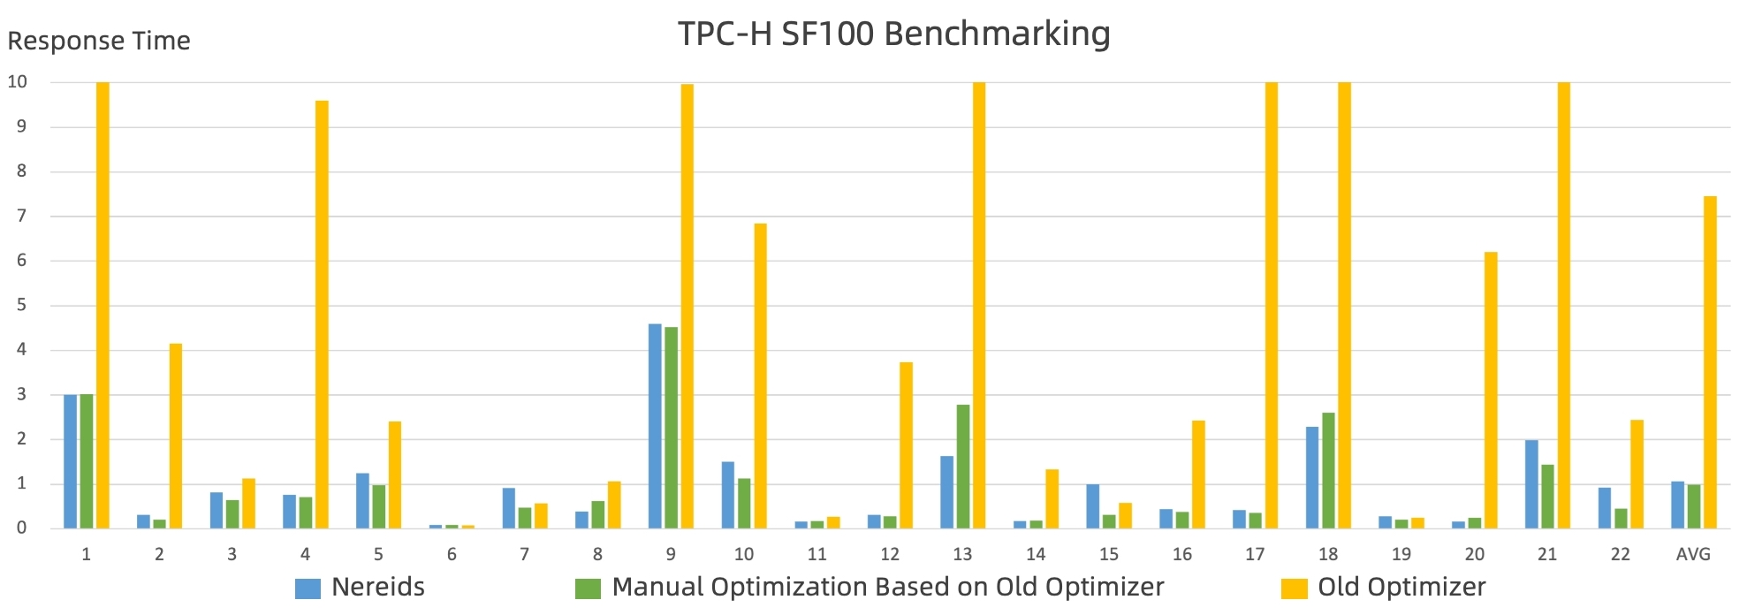
Cost-based Optimizer - Nereids

Slide 10
MPP Architecture
Massively Parallel Processing (MPP) Architecture
- a distributed computing approach where a large task is divided into smaller tasks that can be executed in parallel across multiple processing units or nodes
Relationship between these nodes
Each node typically operates independently, processing a portion of the data, and then the results are combined to produce the final output.
Advantages
High scalability + Fault tolerance + Query Coordination + Parallel Query Execution

Slide 11
Fully-vectorized Query engine
Definition
- a type of database engine that enhances query performance by processing data in batches or vector instead of one row at a time
In detail
Data is stored in a fixed size block, including many data points and can be applied an operator onto this vector.
Supporters
CPU with Single Instruction Multiple Data (SIMD) and distributed parallel system

Slide 12
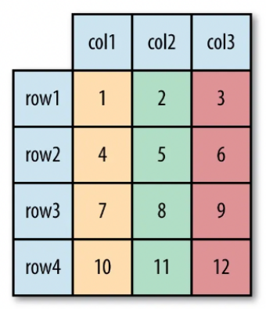
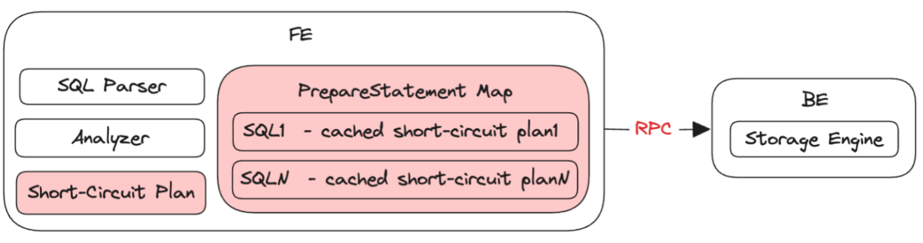
Columnar format & Hybrid memory structure
Columnar format
- Allows for efficient data compression and sharding + Suitable for OLAP
- Not suitable with point query, because it requires much I/O time.
Combination with vectorization
Columnar-formatted data strongly support the Doris’s vectorized query engine
Hybrid memory structure
With a short circuit plan, prepared statements pre-compute and cache SQL statements, Hybrid memory structure can improve the performance for high-concurrency point queries.

Slide 13
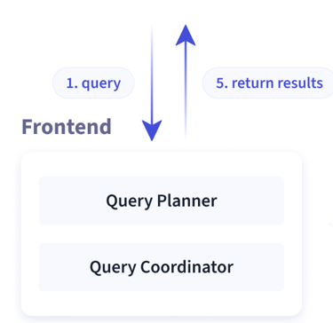
Short circuit
Definition
When a simple query is executed, instead of going through the entire query planning process, Doris directly executes the query without involving the query planner.
Improvement
This approach will bypass unnecessary overhead and improves query execution speed.

Slide 14
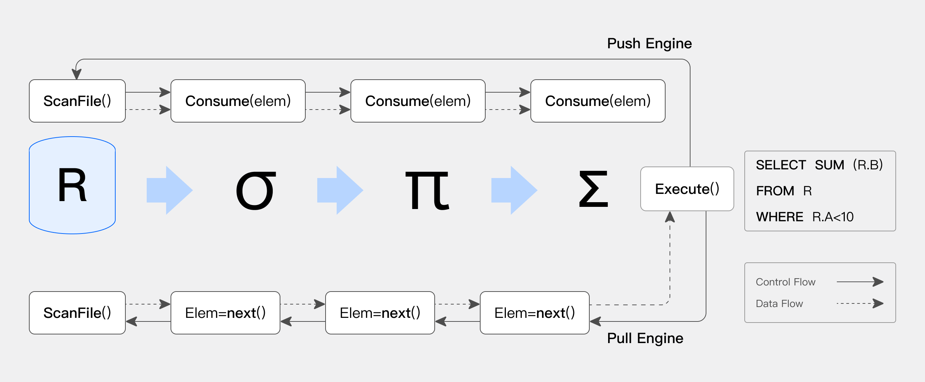
Pipeline execution
Development
based on the traditional volcano model and make the execution engine adapted to the architecture of modern multi-core CPUs.

Slide 15
Smart caching
Features
This smart caching strategy ensures data consistency, minimizes additional system complexity, and improves query efficiency without external cache components.
Demand scenarios
Smart caching is particularly useful in several scenarios: read-heavy data analysis, high concurrency, repeated queries, etc.
Configuration
The caching figures can be completely configured: cache_result_max_row_count, cache_result _max_data_size, cache_last_version_interval_second , etc.

Slide 16
Indexing
Built-in smart indexes
Sorted keys and prefix index: creates a prefix index every 1024 rows, using the first row’s key value. This helps quickly locate and scan relevant data for queries involving sorted columns.
ZoneMap index: records Min/Max values for each column at segment and page levels, allowing quick data filtering for queries.
User-created secondary index
Bloom Filter Index: suitable with Tinyint, Float, and Double and only has an acceleration effect on in and = filtering queries.
N-Gram Bloom Filter Index: only support Char/Varchar/String and exclusive on same column.
Bitmap Index: support number type, Date, Char and Varchar and can be created on single column which can be any column in Duplicate and Unique model or key column in Aggregate model.
Inverted Index: allow fast full-text search and accelerate normal equal, range query (replacing bitmap).

Slide 17
Materialized view
Definition
- a database object that stores the result set of a query as a physically persistent table.
Main advantages
It allows users to pre-compute and store the results of complex queries, thereby improving query performance and reducing the overhead of executing the query each time it is needed.
Main disadvantages
Having too many materialized views on a single table can slow down data imports due to synchronous updates.

Slide 18
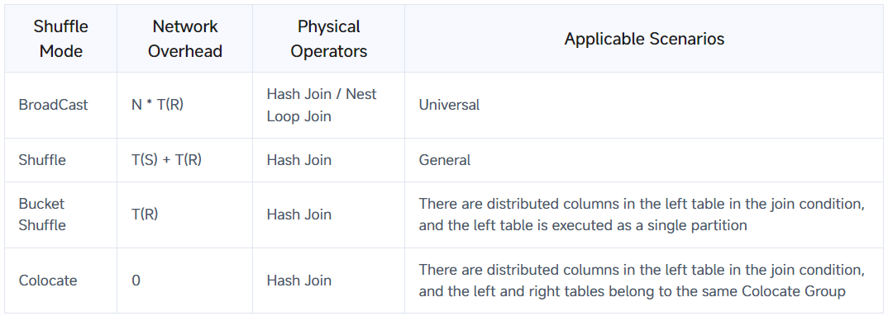
Join optimization
Hash Join
Create a hash table on the right table based on the join column. Use this hash table to perform join calculations on the left table in a streaming manner. This method is limited to equivalent joins.
Nested loop Join
Uses 2 for loops and supports unequal-valued joins (e.g., greater than, less than) and Cartesian products. While it is a general join operator, it performs poorly.
Doris shuffle way

Slide 19
Partition and Projection
Partition
Partitions are the small and more manageable pieces after dividing a table, based on a specified column or set of columns. Each partition can be stored and queried independently.
Projection
Defines a subset of table columns for queries. Each projection has its own schema. Users can customize schemas for better query performance and storage efficiency
Advantages
Efficient Storage Utilization
Performance Optimization

Slide 20
Core
Capability
03
Core Capability
03
Notes:
Note: Please after inserting your picture, “Right Click” on the picture and “Send it to Back” to get the “Gradient” effect.

Slide 21
High concurrency
Technique support:
Hybrid-storage
Short circuit plan
PreparedStatment
Use cases:
Customer-facing: A substantial volume of users concurrently seek with only a one or two data rows, etc.
Machine-facing: real-time risk control, IoT, etc.

Slide 22
Service availability & Data reliability
High availability
Both the front-end and back-end processes are scalable, therefore it totally allow upgrading or scaling cluster without any interruptions for the whole services and business.
Data backup & Recovery
For data reliability, Apache Doris supports snapshot backup and snapshot restoration both at the table level and partition level (data backup to HDFS or object storage).
Cross Cluster Replication (CCR)
- a mechanism that enables the replication of data across multiple geographically or logically separated database clusters and achieve high availability, fault tolerance, disaster recovery, and load balancing.

Slide 23
High performance data ingestion
General
Data ingestion in Apache Doris involves the process of importing and integrating data from various sources into the Doris system for storage, analysis, and querying. Apache Doris supports multiple data ingestion methods to accommodate different types of data and ingestion scenarios.
Wide range of methods
Broker load
Stream load
Routine load
Insert load
Flink-Doris Connector
Spark-Doris Connector

Slide 24
Data Update
Update in Unique model
Merge-on-Read: is optimized for write operations with low-frequency batch updates.
Merge-on-Write: is suitable for real-time writing optimized for faster analysis performance.
In actual tests, the analysis performance of MoW storage can be 5-10 times faster than MoR with light merge upon writing.
Support most updates: Upsert, partial column update, conditional update/deletion, partition overwrite,…
Update in non-primary key model
Partial column update by replace_if_not_null
Support data deletion based on specified conditions or date expressions (curdate(), etc)

Slide 25
04
04
Comparison
Comparison
Notes:
Note: Please after inserting your picture, “Right Click” on the picture and “Send it to Back” to get the “Gradient” effect.

Slide 26
Compare with Clickhouse and Trino (Presto)
Trino (Presto)
Trino excels in federated queries across heterogeneous data stores and is highly scalable, making it suitable for complex analytical environments.
Clickhouse
ClickHouse offers superior speed for read-intensive scenarios, especially with its advanced data compression and fast data retrieval capabilities, ideal for environments where query latency is critical.
Apache Doris
Apache Doris provides a balance between high performance and ease of use in real-time analytics, supporting high query concurrency and rapid data updates.

Slide 27
Typical
use case
05
Typical
use case
05
Notes:
Note: Please after inserting your picture, “Right Click” on the picture and “Send it to Back” to get the “Gradient” effect.

Slide 28
Real-time writes from Flink to Apache Doris
Streaming write
Chunked transfer encoding
Checkpointing mechanism
Exactly once
Exactly-once semantics is implemented on the basis of Flink's two-stage submission, with the help of Doris 1.0's Stream Load two-stage submission.
Second-level Data synchronization
Transaction processing capability: Stream Load 2pc (2 phase-commit) ensure ACID and high concurrency.
Rapid Aggregation Capability of Data versions: Quick compaction (+ scan fragment information), Cumulative Compaction, Gradient merge method.

Slide 29
06
06
Demonstration
Demonstration
Notes:
Note: Please after inserting your picture, “Right Click” on the picture and “Send it to Back” to get the “Gradient” effect.

Slide 30
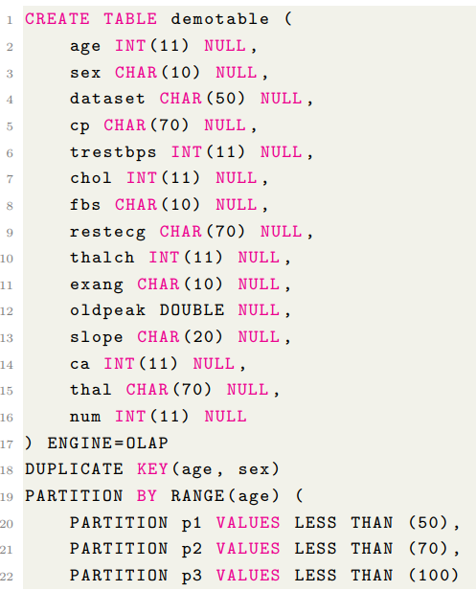
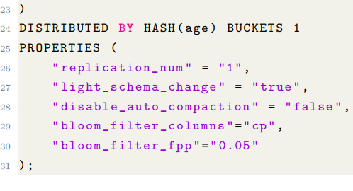
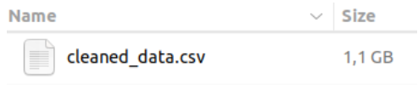
Table initiation & Insert Data

Slide 31
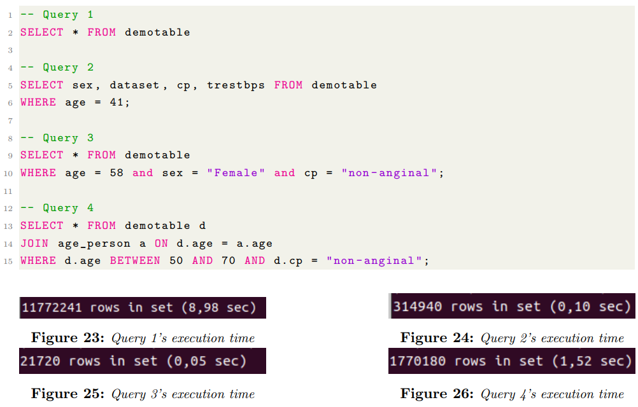
…

Slide 32
THANK YOU
THANK YOU

Slide 33

Q&A
Q&A

Slide 34
…
…
…
…
…
…
…

